Slide 1
Mitigating Bias in Digital Media Content by Classifying toxic and Profane Comments
-Ayush Dwivedi

Slide 2
Introduction
Increased Cyber Bullying and Harassments like Trolling affect the mental health of the target and also the readers.
Platforms can not hold meaningful discussions and have to curb the entire process of commenting and feedback discussions.
Cyber Bullying has been declared as one of the major problems by the National Crime Prevention Centre and the statistics given by them on the next page prove that.
95% of the teens are connected to the internet and 85% are the social media users and because of this fact it becomes even more important to address this problem.

Slide 3
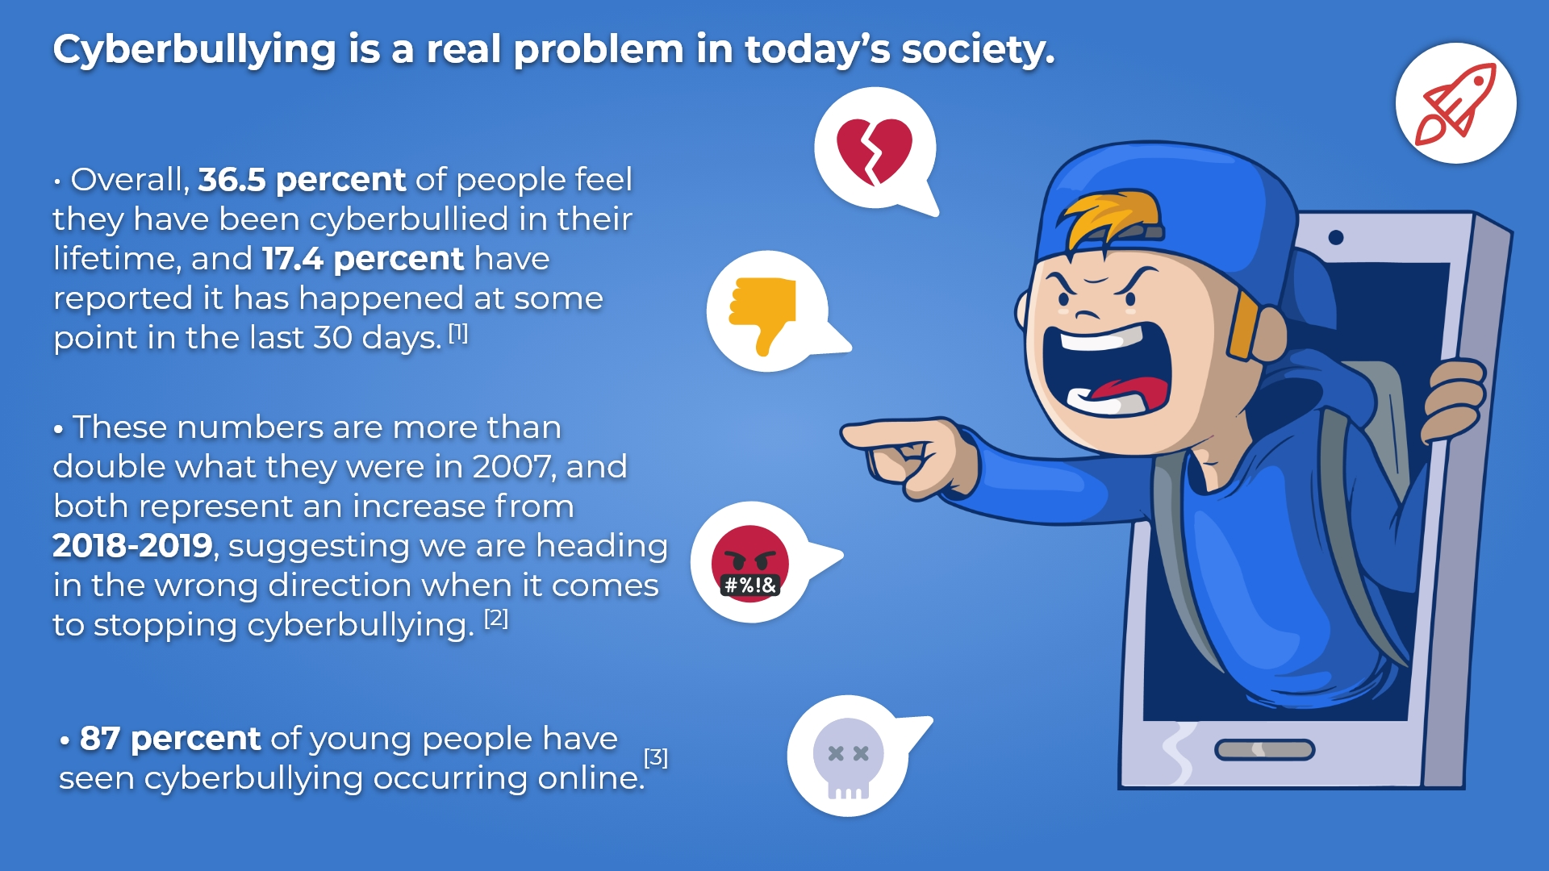

Slide 4
Related work in the field
Detection of Social Network Toxic Comments with Usage of Syntactic Dependencies in the Sentences by Shtovba et al.
Challenges for Toxic Comment Classification: An In-Depth Error Analysis by Aken et al.
Measuring and Mitigating Unintended Bias in Text Classification by Dixon et al.
Ex Machina: Personal Attacks Seen at Scale by Wulczyn et al.

Slide 5
Data Source Used
I used the dataset from Kaggle
The dataset contains large number of wikipedia comments hand labelled by human raters for their toxicity.
The dataset has more than 300k hand labelled instances.
The Target labels have been defined with the following labels
Toxic
Severe Toxic
Obscene
Threat
Insult
Identity hate

Slide 6
Data Pre Processing
I did the following steps for the Pre Processing of the data
Removed all the unwanted character
Encoding in UTF 8 format
Tokenization and Decapitalisation
Removing all the stop words
Breaking the attached words
Lemmatization and Stemming
Using TF-IDF Vectorizer

Slide 7
Data Inspection and Analysis
.

Slide 8
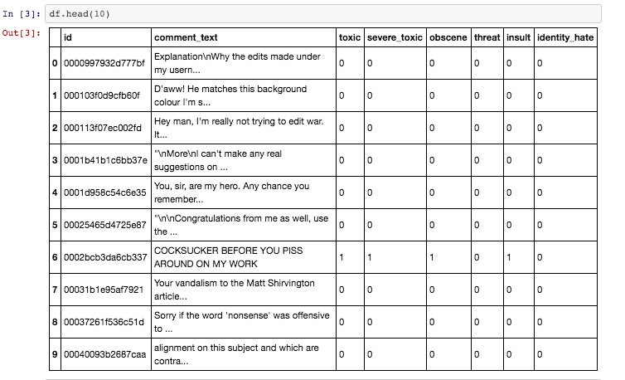
Sample Dataset
.

Slide 9
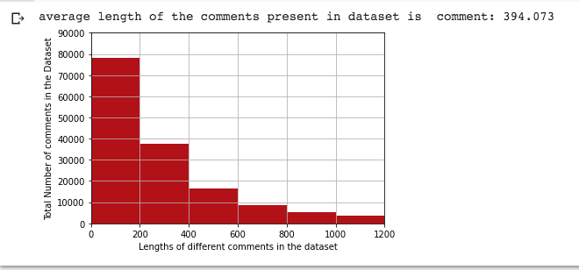
Average Length of the comments present in Dataset

Slide 10
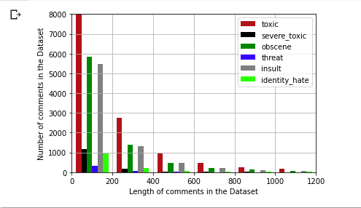
Length of the Comments in the Data Set

Slide 11
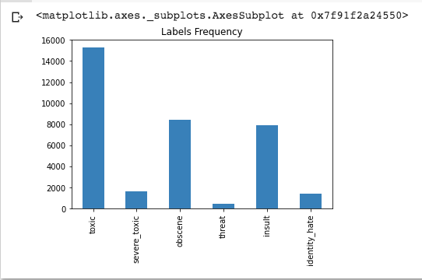
Class Distribution of the data set

Slide 12
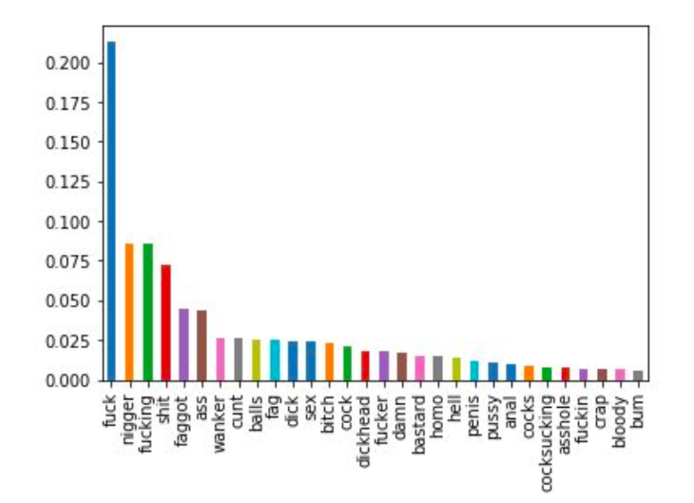
Toxic Words with their frequency of Occurrences

Slide 13
Approach
I tried to compare the performance of the various machine learning and Ensemble Methods for their performance on accurately classifying the toxic comments.
In Machine Learning I created Logistic Regression, Multinomial Naive Bayes and Random Forest Classifier.
To test the Ensemble technique I implemented Adaboost Algorithm.
The finally I implemented my Proposed Ensemble Method which is a Voting Classifier which was made by the ensemble of Logistic Regression and Adaboost model.
I calculated the Recall and F1 score to calculate the accuracy of each Classifier.

Slide 14
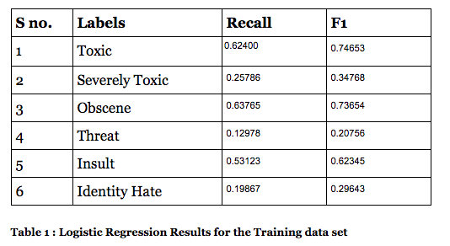
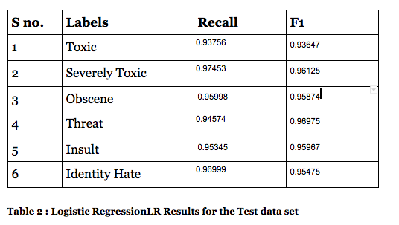
Logistic Regression Model Results

Slide 15
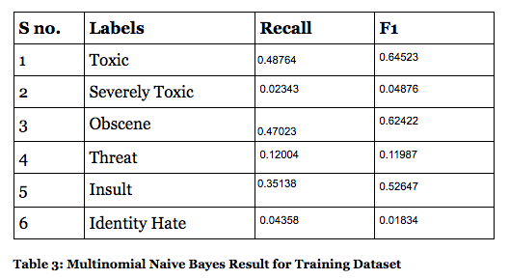
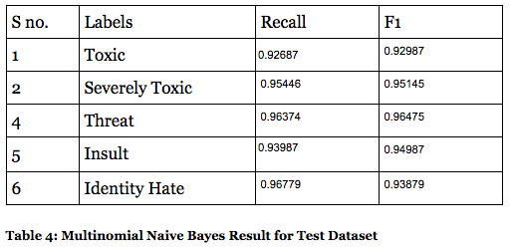
Multinomial Naive Bayes Model Result

Slide 16
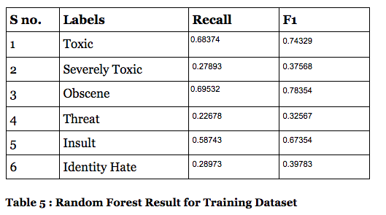
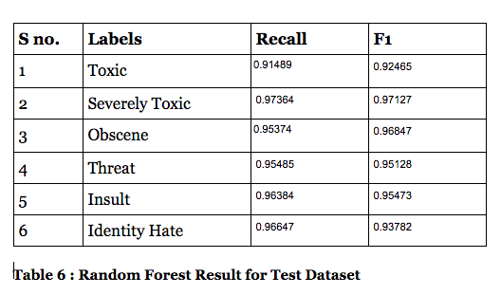
Random Forest Classifier Results

Slide 17
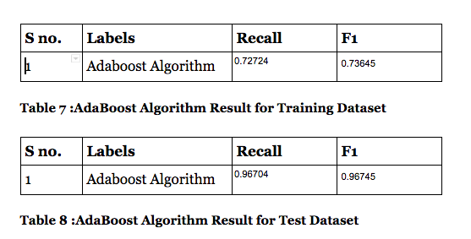
Adaboost Ensemble Model
.

Slide 18
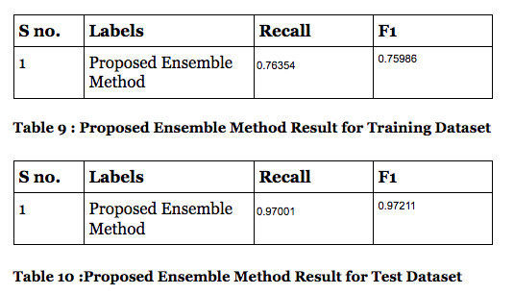
Proposed Voting Classifier Ensemble Model
.

Slide 19
Conclusion
So in our work we saw that the Ensemble Methods perform better than the regular Machine Learning Models.
Adaboost Ensemble Model outperformed all of the Machine Learning Models.
Our Proposed Voting Classifier Model which was an ensemble of Logistic Regression and Adaboost Algorithm performed better than the standalone Adaboost Ensemble model.

Slide 20
Future Work
Toxic Comment Classification remains a budding area of research.
We proposed a few techniques but other techniques can be explored as well for even better Classification accuracy.
Better work can be done on Vectorizing data.
We can explore feature engineering in even greater detail and things like Spelling Corrector, Sentiment scores etc can be explored.
We can use even more advanced techniques like using Deep Learning and implementing LSTM and CNN.
More Advanced hyperparameter tuning techniques can be used.

Slide 21
Thank you for your Time !!!!!
AND STAY SAFE

Slide 22
References Used
https://www.broadbandsearch.net/blog/cyber-bullying-statistics
Shtovba, S., Petrychko, M., & Shtovba, O. V. (2019, April 17). (PDF) Detection of Social Network Toxic Comments with Usage of Syntactic Dependencies in the Sentences. Retrieved from https://www.researchgate.net/publication/332835127_Detection_of_Social_Network_Toxic_Comments_with_Usage_of_Syntactic_Dependencies_in_the_Sentences
Aken, van, Betty, Risch, Julian, Krestel, Ralf, … Alexander. (2018, September 20). Challenges for Toxic Comment Classification: An In-Depth Error Analysis. Retrieved from https://arxiv.org/abs/1809.07572
Dixon, L., Li, J., Sorensen, J., Thain, N., & Vasserman, L. (1970, January 1). Measuring and Mitigating Unintended Bias in Text Classification. Retrieved from https://research.google/pubs/pub46743/
https://medium.com/@nupurbaghel/toxic-comment-classification-f6e075c3487a
https://towardsdatascience.com/reading-between-the-layers-lstm-network-7956ad192e58
https://towardsdatascience.com/sentiment-analysis-using-lstm-step-by-step-50d074f09948

